Slide 1
A Comparative Study of Machine Learning and Deep Learning for Brain Tumor Detection Course: Machine Learning Supervised by DR. MD. ASRAF ALI

Slide 2
Group Members
Name | ID
Piyash Majhi | 22-46572-1
Md Yeasin Newaz | 22-46803-1
Rokaiya Ibne Tanha | 22-48833-3
Anindita Bhattacharjee | 22-48606-3

Slide 3
Background
Brain-related cancers are one of the main causes of death worldwide [1]. Brain tumor is a deadly disease and its classification is a challenging task for radiologists because of the heterogeneous nature of the tumor cells.
Recently, computer-aided diagnosis-based systems have promised, as an assistive technology, to diagnose the brain tumor, through magnetic resonance imaging (MRI). Meningioma represented 36.3% (29,320), Gliomas 26.5% (21,200), Pituitary tumors represented nearly 16.2% (13,210) and rest of the cases belonged to other types of brain tumor such as Malignant, Medulloblastoma, and Lymphomas [2]. In the USA, almost 23,000 patients were identified brain tumor cancer in 2015 [2].

Slide 4
Motivation
Brain tumors are among the most critical and life-threatening conditions in the field of neurology. Early and accurate detection of brain tumor is crucial for timely intervention and effective treatment. In recent years, the involvement of Artificial Intelligence (AI) into medical imaging has emerged as a powerful tool to aid radiologists in improving diagnostic accuracy and efficiency.
Machine Learning (ML) and Deep Learning (DL) are two prominent subfields of AI that have shown outstanding promise in medical image analysis. ML techniques often require handcrafted features and classical classifiers such as Support Vector Machines (SVM), k-Nearest Neighbors (k-NN),XG Boost and Logistic Regression. In contrast, DL models, especially Convolutional Neural Networks (CNNs) and MobileNetV2 automatically extract hierarchical features from raw image data, eliminating the need for manual feature engineering.

Slide 5
Objective
The objective of this research is to develop a comparative framework for brain tumor detection using Machine Learning (ML) and Deep Learning (DL) techniques on MRI images to evaluate the effectiveness of traditional ML algorithms, such as SVM, k-NN, XGBoost, and Logistic Regression, against DL models like Convolutional Neural Networks (CNNs) and MobileNetV2 that extract features from raw image data.
The review involves preprocessing medical images, implementing and training both ML and DL models, and conducting a performance comparison based on evaluation metrics such as accuracy, precision, recall, F1-score, and computational efficiency.
This comparative analysis is intended to highlight the strengths and limitations of each approach and provide guidance for future advancements in AI-assisted brain tumor diagnosis.

Slide 6
Methodology
Dataset Collection
Kaggle Brain Tumor MRI Dataset
https://www.kaggle.com/datasets/masoudnickparvar/brain-tumor-mri-dataset
Over 7,034 grayscale MRI images (Glioma, Meningioma, Pituitary, Non-tumor)
Data Preprocessing
Removed corrupted/duplicate images
Resized all images to 224×224
Normalized pixel values to [0,1]
Histogram Equalization for contrast enhancement

Slide 7
Methodology: Feature Extraction & Train-Test Split
Handcrafted Feature Extraction (for ML):
LBP (Local Binary Pattern): texture descriptor
HOG (Histogram of Oriented Gradients): shape & edge detection
Train-Test Split:
Training Set: 5712 images
Testing Set: 1311 images
A stratified sampling strategy was applied to the dataset. From the training set, 70% was used for training, 15% for validation, and 15% for testing, ensuring label distribution is maintained across all subsets.
Notes:
Good morning, everyone. Today, I’m here to share with you the methodology behind our research on brain tumor classification using MRI images.
For feature extraction, we used handcrafted techniques suitable for traditional machine learning models. Specifically, we applied Local Binary Pattern (LBP) to capture texture features and Histogram of Oriented Gradients (HOG) to detect shapes and edges in the images.
Regarding the train-test strategy, we began with a total of 5,712 images for training and 1,311 for testing. To maintain class balance, we used a stratified sampling approach. Within the training set, we further split the data into 70% for training, 15% for validation, and 15% for testing, ensuring that the distribution of tumor types remained consistent across all subsets.

Slide 8
Methodology: Data Augmentation
Data Augmentation Techniques:
Random Rotation: Up to ±15°
Horizontal and Vertical Flipping
Zooming: Up to 20%
Translation: Up to 10% in both horizontal and vertical directions
To enhance model generalization and reduce overfitting, various data augmentation strategies were employed during training. These include:
Notes:
To improve the model’s ability to generalize and reduce the risk of overfitting, we applied several data augmentation techniques during training. These included random rotations up to ±15 degrees, horizontal and vertical flipping, zooming up to 20%, and translations up to 10% in both directions. These transformations helped create more variability in the dataset without collecting new images, making the model more robust.

Slide 9
Methodology: Machine & Deep Learning Algorithm
Machine Learning
SVM (RBF kernel): Max-margin classifier
Random Forest: Ensemble of decision trees
K-Nearest Neighbors: Based on closest training examples
Logistic Regression: Probabilistic linear classifier
XGBoost: Gradient-boosted decision tree algorithm optimized for speed and performance
Deep Learning
Custom CNN: 3 Conv blocks, FC layers, Softmax
MobileNetV2: Transfer learning from ImageNet, Lightweight, Final classifier layers replaced for binary classification
Notes:
We used both machine learning and deep learning approaches for classification.
For machine learning, we experimented with several models:
SVM with RBF kernel for finding optimal decision boundaries,
Random Forest, which is an ensemble of decision trees,
K-Nearest Neighbors, based on the closest training examples,
Logistic Regression, a simple yet effective probabilistic model,
And XGBoost, a fast and powerful gradient-boosted tree algorithm.
On the deep learning side, we built a custom CNN with 3 convolutional blocks followed by fully connected layers and softmax for classification. We also used MobileNetV2 through transfer learning from ImageNet. It’s a lightweight model where we replaced the final layers to adapt it for binary classification.

Slide 10
Methodology : Model Architectures
Takes grayscale MRI input (224×224×1)
3 Conv2D layers (32→64→128 filters) with ReLU
MaxPooling after each Conv layer
Flattened, passed to Dense layer (128 units)
Final Dense (2 units) with Softmax → Tumor / Non-Tumor
Learns features automatically for efficient classification
Notes:
This diagram shows the CNN architecture designed for classifying brain MRI images. We start with a grayscale input of size 224 by 224. The model includes three convolutional layers, each followed by ReLU activation and max-pooling to reduce spatial dimensions while retaining key features. The number of filters increases with depth—32, then 64, and finally 128—to capture more complex patterns. After feature extraction, we flatten the output and pass it to a dense layer with 128 units. Finally, a softmax output layer with 2 units classifies the image as either Tumor or Non-Tumor. This end-to-end architecture automatically learns useful features for accurate and efficient tumor detection.

Slide 11
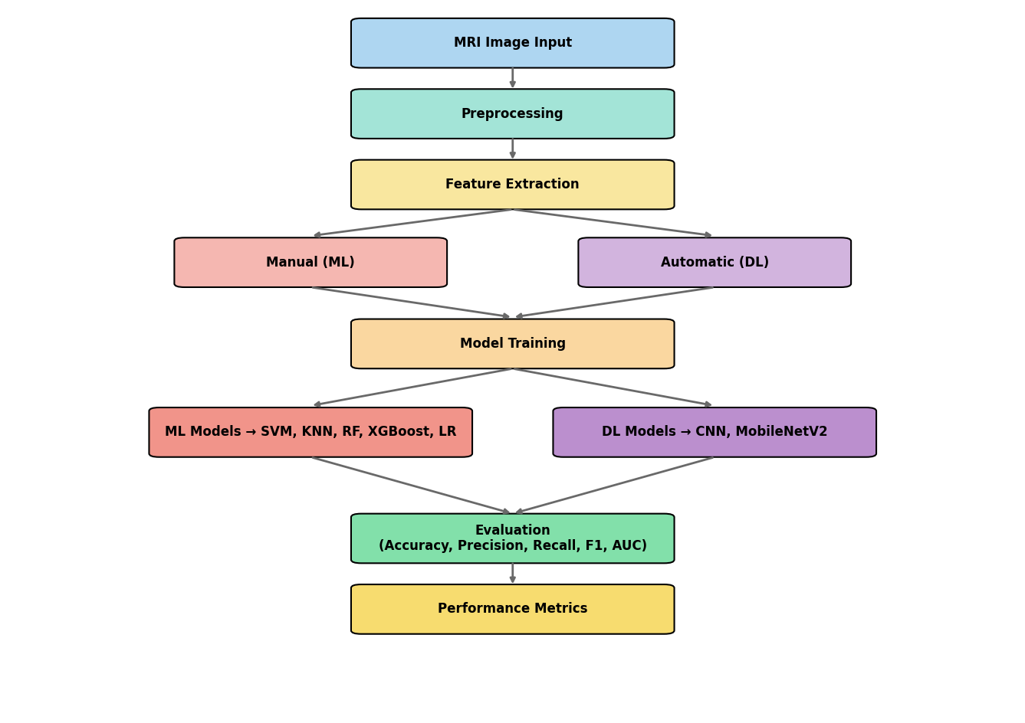
Methodology: Block Diagram
The diagram presents a complete MRI-based brain tumor classification pipeline, covering preprocessing, feature extraction, and model training using both ML (SVM, KNN, RF, XGBoost, LR) and DL (CNN, MobileNetV2) methods. Evaluation is based on metrics like accuracy, precision, recall, F1-score, and AUC for comparative analysis.
Notes:
This block diagram illustrates the complete end-to-end pipeline for brain tumor classification using MRI images. We start with the MRI image input, which undergoes essential preprocessing to enhance image quality. Next, feature extraction is performed either manually using traditional methods for ML models or automatically through DL-based architectures like CNNs. These features are then fed into the model training phase. For machine learning, we experimented with models like SVM, KNN, Random Forest, XGBoost, and Logistic Regression, while for deep learning, we used CNNs and MobileNetV2. The models are then evaluated based on key metrics such as accuracy, precision, recall, F1-score, and AUC, which ultimately inform us about the overall performance of the classification system.

Slide 12
Result
ML Model | Class | Precision | Recall | F1-Score
SVM | Glioma | 0.96 | 0.90 | 0.93
 | Meningioma | 0.91 | 0.93 | 0.92
 | No-tumor | 0.99 | 1.00 | 0.99
 | Pituitary | 0.98 | 0.99 | 0.98
Decision Tree | Glioma | 0.81 | 0.72 | 0.76
 | Meningioma | 0.70 | 0.79 | 0.74
 | No-Tumor | 0.93 | 0.96 | 0.94
 | Pituitary | 0.87 | 0.81 | 0.84
Logistic Regression | Glioma | 0.94 | 0.89 | 0.91
 | Meningioma | 0.89 | 0.90 | 0.89
 | No-tumor | 0.98 | 1.00 | 0.99
 | Pituitary | 0.97 | 0.98 | 0.97
Comparative study analysis
SVM- Proposed model accuracy is 96%.
ICA-NN-SVM model accuracy is 98.9%[1]
Decision Tree-Proposed model accuracy is 83%
Existing model accuracy is 94% [4]
Logistic Regression-Proposed model accuracy is 95%
Logistic-regression based model accuracy is 97%[3]

Slide 13
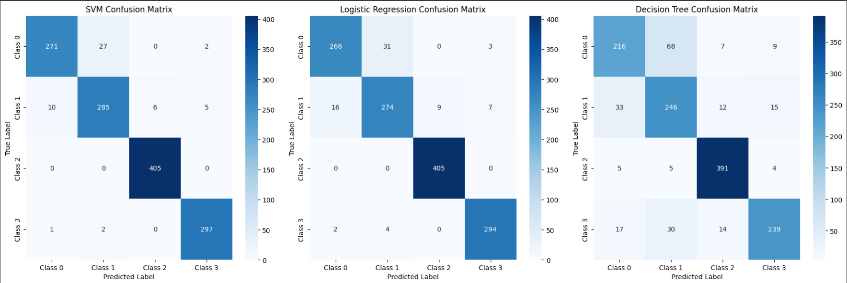
Result(Cont.) Confusion Matrix

Slide 14
Result(Cont.)
ML Model | Class | Precision | Recall | F1-Score
K-NN | Glioma | 0.95 | 0.90 | 0.93
 | Meningioma | 0.86 | 0.70 | 0.77
 | No-tumor | 0.91 | 0.97 | 0.94
 | Pituitary | 0.86 | 0.99 | 0.92
XG-Boost | Glioma | 0.95 | 0.86 | 0.90
 | Meningioma | 0.87 | 0.92 | 0.89
 | No-Tumor | 0.98 | 1.00 | 0.99
 | Pituitary | 0.97 | 0.98 | 0.98
Comparative Study Analysis
KNN-Proposed Model accuracy is 90% Hybrid machine learning algorithm (KNN) accuracy is 61.24% [5]
XGBoost- Proposed Model accuracy is 94%

Slide 15
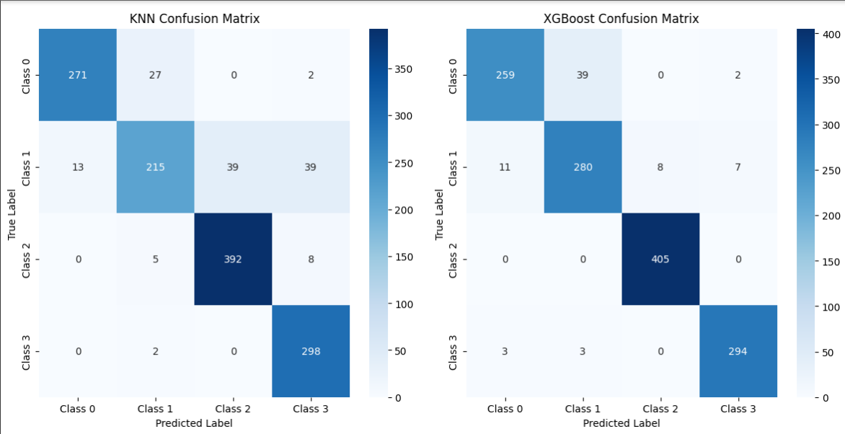
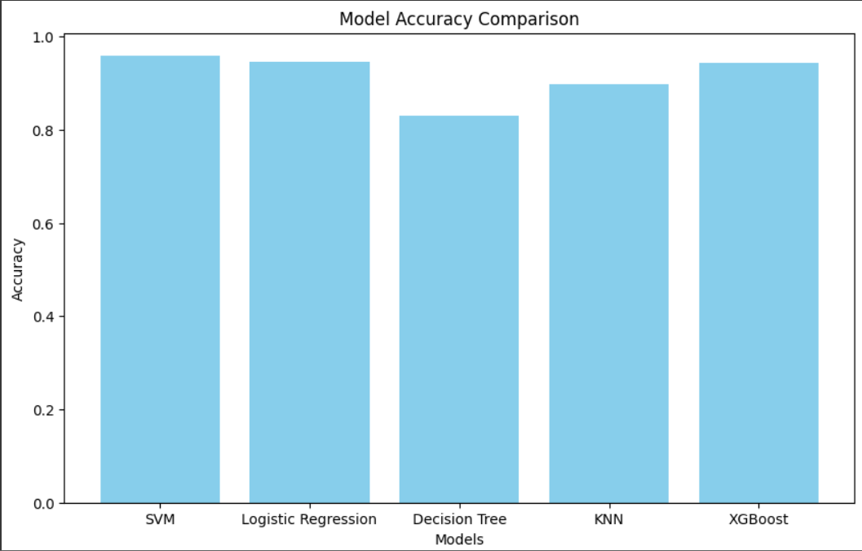
Result(Cont.) Confusion Matrix & Visualization of Model performance

Slide 16
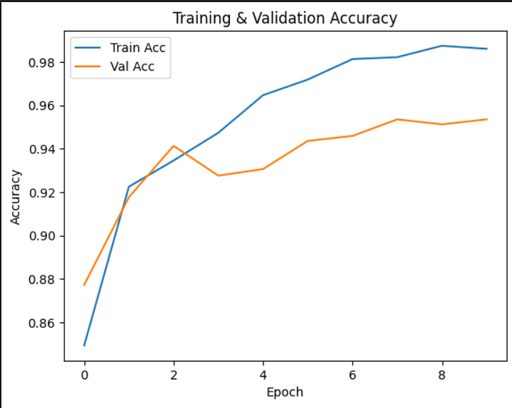
Result(Cont.)
CNN-The accuracy is 96% which is pretty good. And the existing work on CNN model accuracy is 84.19%[6]
MobileNetV2- The proposed model accuracy is 95%

Slide 17
Conclusion
This study highlights the strengths and trade-offs between ML and DL for brain tumor detection.
DL models (CNN, MobileNetV2) matched with ML models.
SVM and Logistic Regression showed strong ML performance.

Slide 18
Future Work
Use advanced DL models (e.g., ResNet, EfficientNet).
Include more diverse and 3D MRI data.
Explore ML-DL ensemble methods.
Apply explainable AI for clinical trust.
Develop a real-time diagnostic tool.

Slide 19
References
[1]A. A. Asiri et al., "Optimized brain tumor detection: A dual-module approach for MRI image enhancement and tumor classification," IEEE Access, vol. 12, pp. 42868–42887, 2024.
[2]N. Noreen et al., "A deep learning model based on concatenation approach for the diagnosis of brain tumor," IEEE Access, vol. 8, pp. 55135–55144, 2020.
[3]S. Gajula and V. R., "An MRI brain tumour detection using logistic regression-based machine learning model," International Journal of System Assurance Engineering and Management, vol. 15, no. 1, pp. 124–134, 2024.
[4]J. Naik and S. P., "Tumor detection and classification using decision tree in brain MRI," International Journal of Computer Science and Network Security, vol. 14, no. 6, pp. 87–94, 2014.
[5]B. Deepa et al., "Pattern descriptors orientation and map firefly algorithm-based brain pathology classification using hybridized machine learning algorithm," IEEE Access, vol. 10, pp. 3848–3863, 2021.
[6]M. H. Abiwinanda et al., "Brain tumor classification using convolutional neural network," in Proc. World Congress on Medical Physics and Biomedical Engineering, pp. 183–189, 2019.

Slide 20
Thank you & We are like to have your question!

